Slide 1
The Great South Bay and the New Inlet
Bellport Middle School, Dec 21, 2013
Charles Flagg, Roger Flood, Robert Wilson and Dong-Ming Yang
Pilots: Rich Giannotti, Charles Flagg, Don Richards & Vinny Petruso
Photographers: Charles Flagg, Rich Weissman, Mike Ferrigno,
Justin Flagg, Brian Wasser, Jamie Shreeve, John Vahey,
Brad Furman, Chris Gobler and Mike Busch
http://po.msrc.sunysb.edu/GSB

Slide 2
Topics
The breach and the evolution of the New Inlet
Bathymetric and Velocity Survey Results
Salinity and Changes in Bay-Ocean Exchange

Slide 3
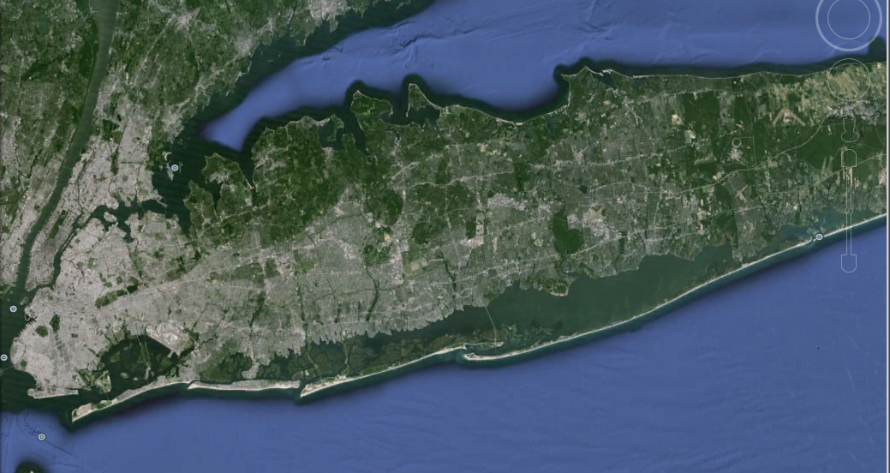
The Great South Bay
76 km
Moriches
New Inlet
Jones
Fire Island
E. Rockaway
Notes:
Amityville

Slide 4
Aerial Photography

Slide 5
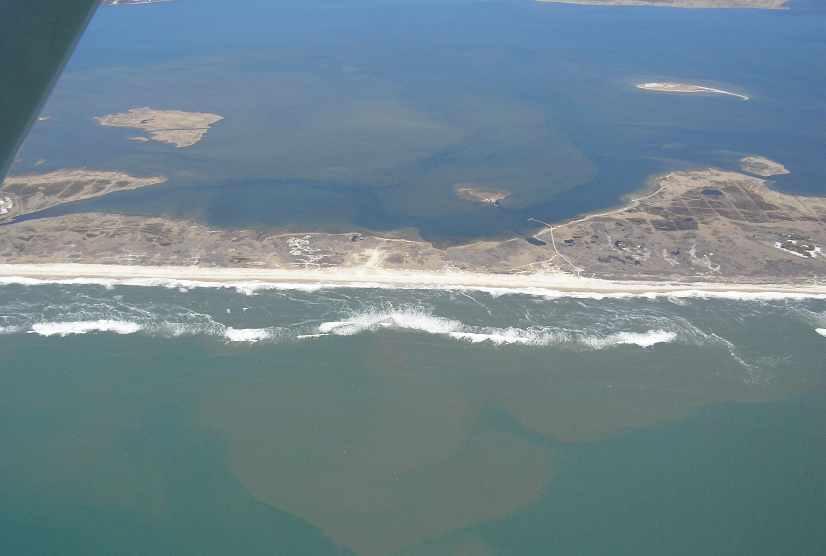
April 9, 2005
C. Flagg
Notes:
5
5

Slide 6
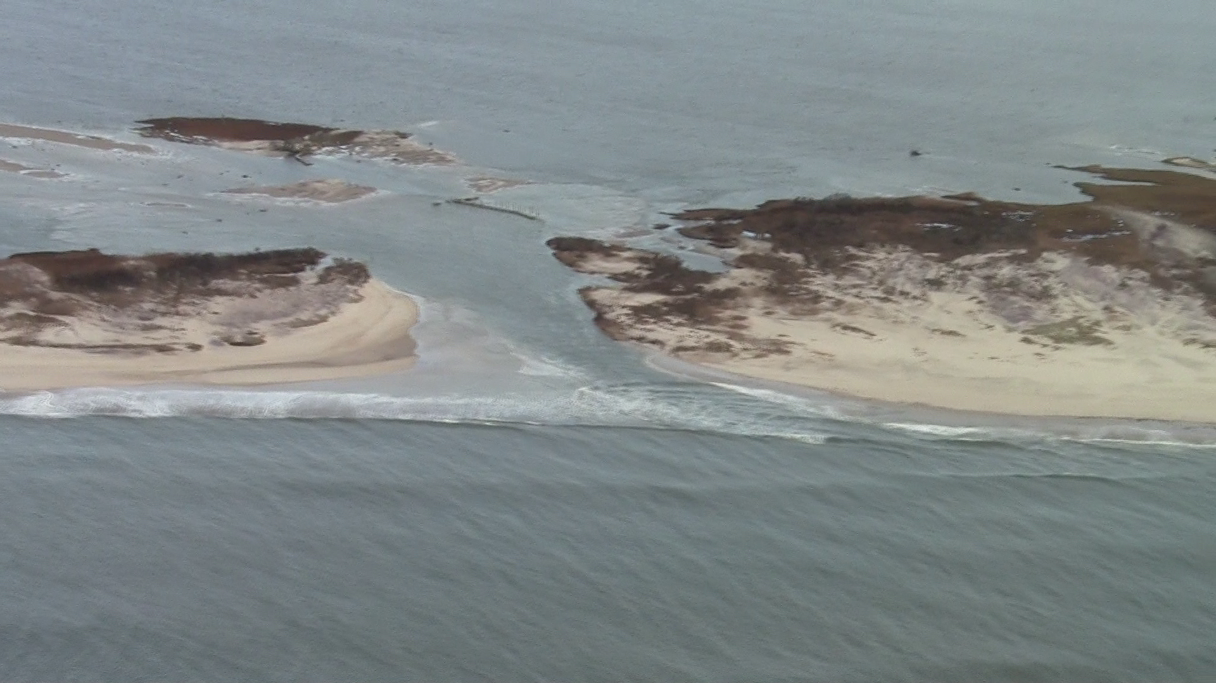
November 3, 2012 ~0900 EDT (~1300 GMT)
C. Flagg and R. Giannotti
Notes:
6
6

Slide 7
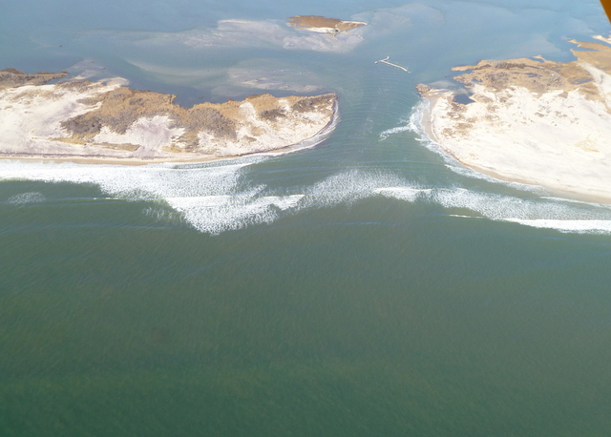
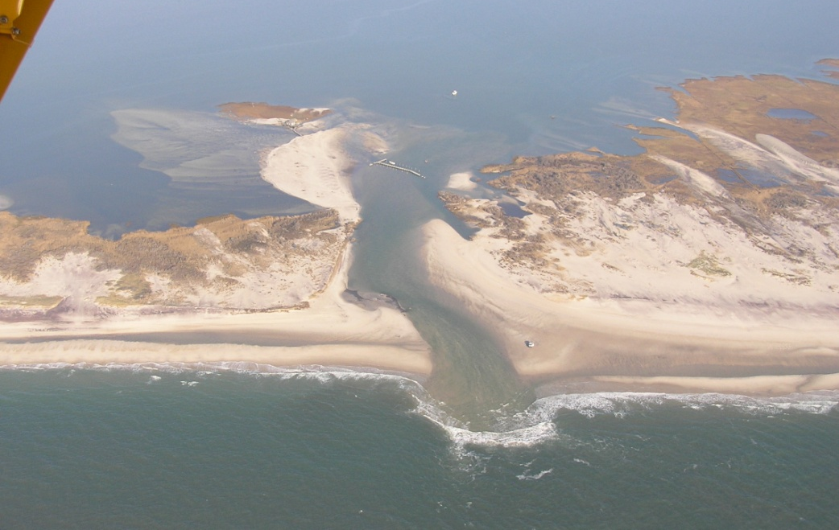
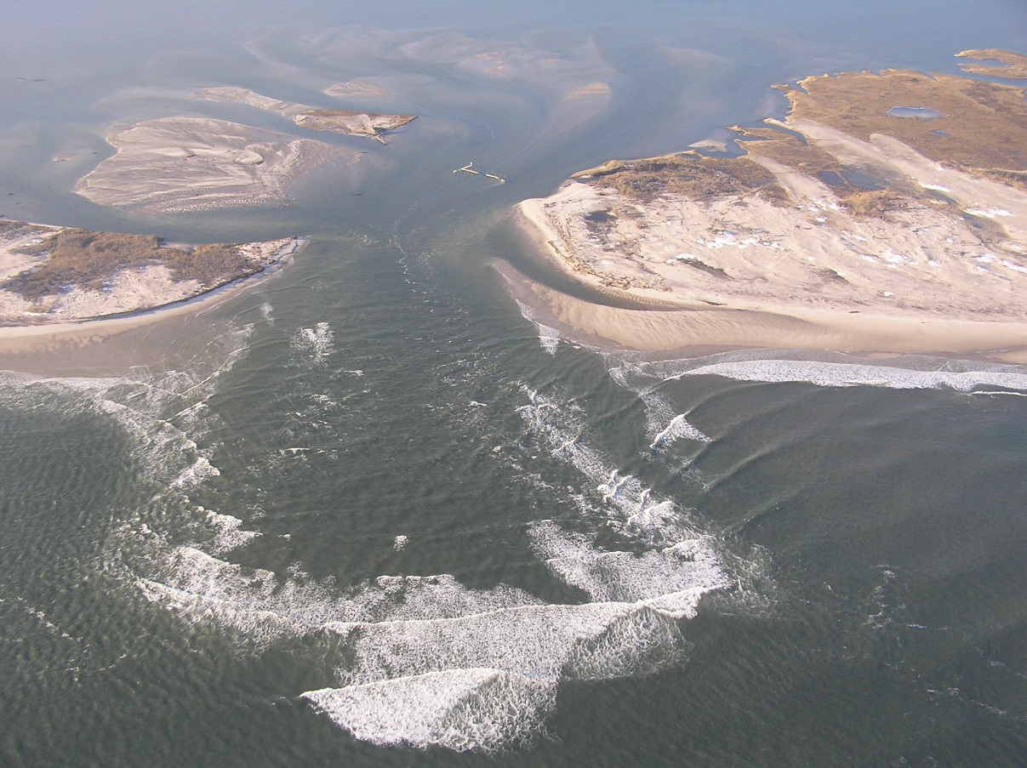
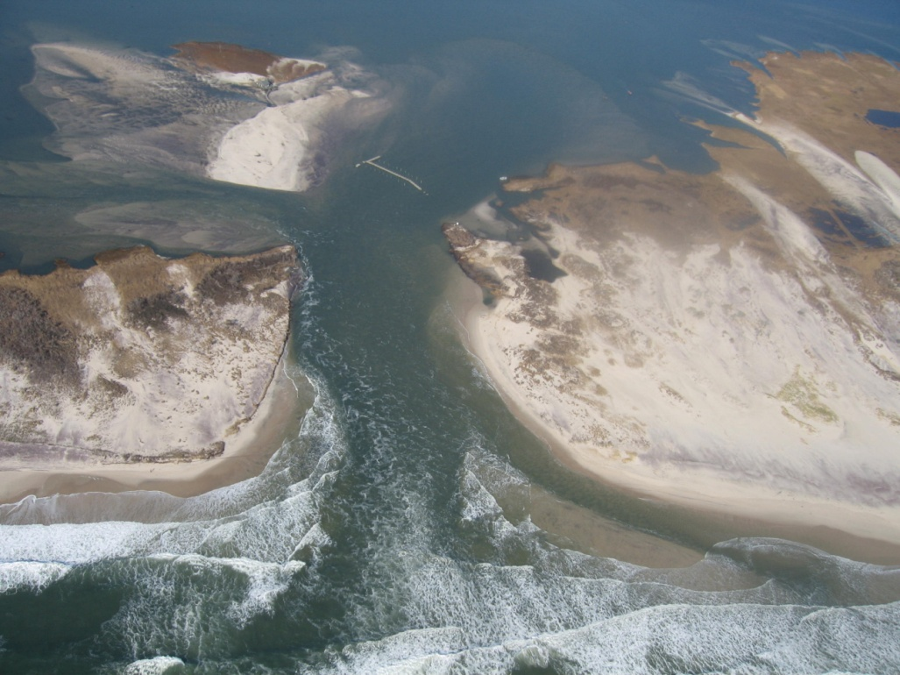
Nov 3
Nov 11
Dec 20
Nov 11
Nov 29
Feb 14
Nov 18
Jan 6

Slide 8
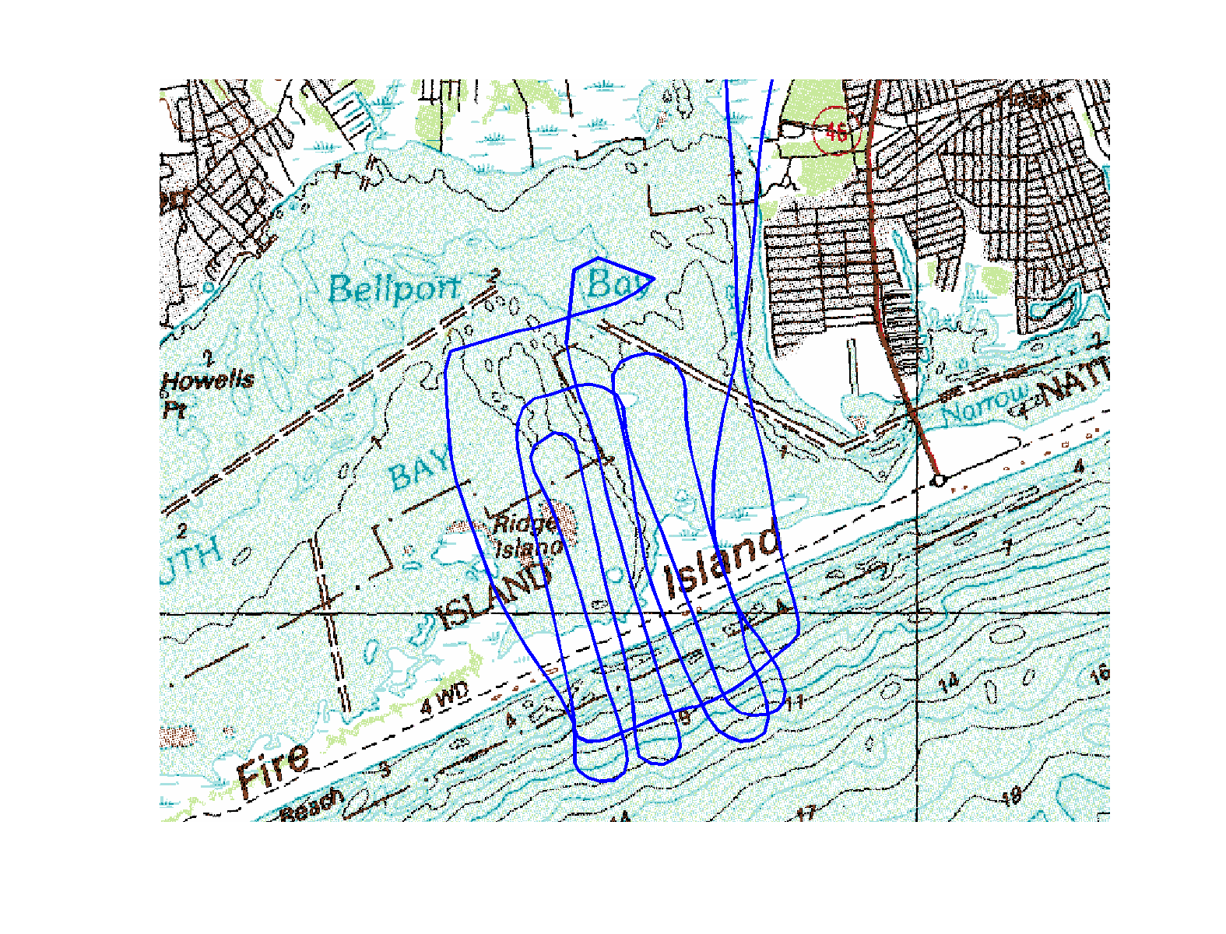
Sept 15, 2013 Flight Track

Slide 9
Google Earth KML file
http://wx.somassbu.org/products/kml/OldInletBreach.kml
showing a series of aerial photo mosaics of the New Inlet

Slide 10
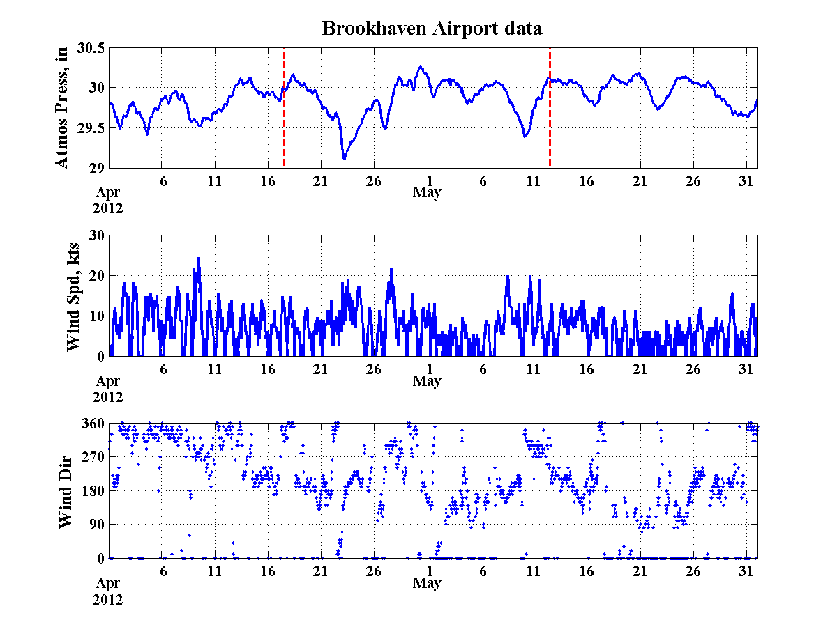
Aerial Photos

Slide 11
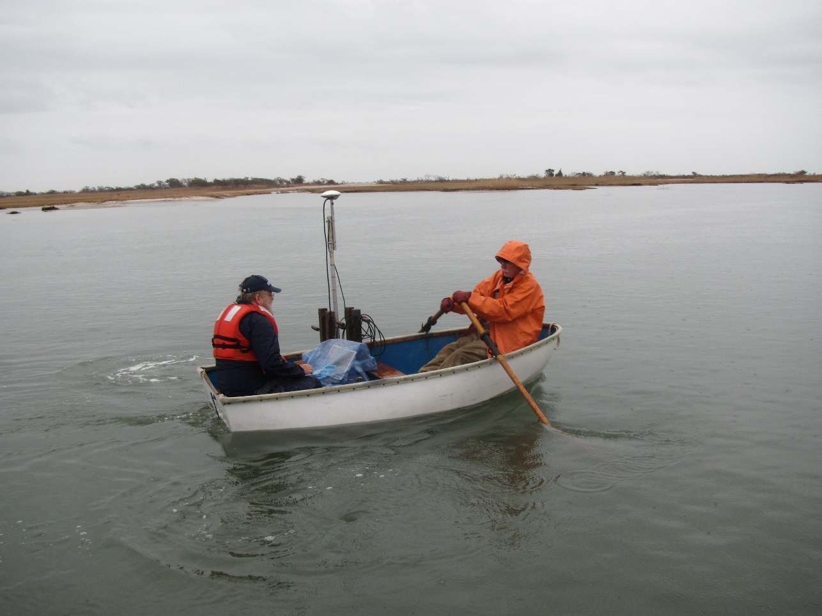
Bathymetric (Depth) Surveying

Slide 12
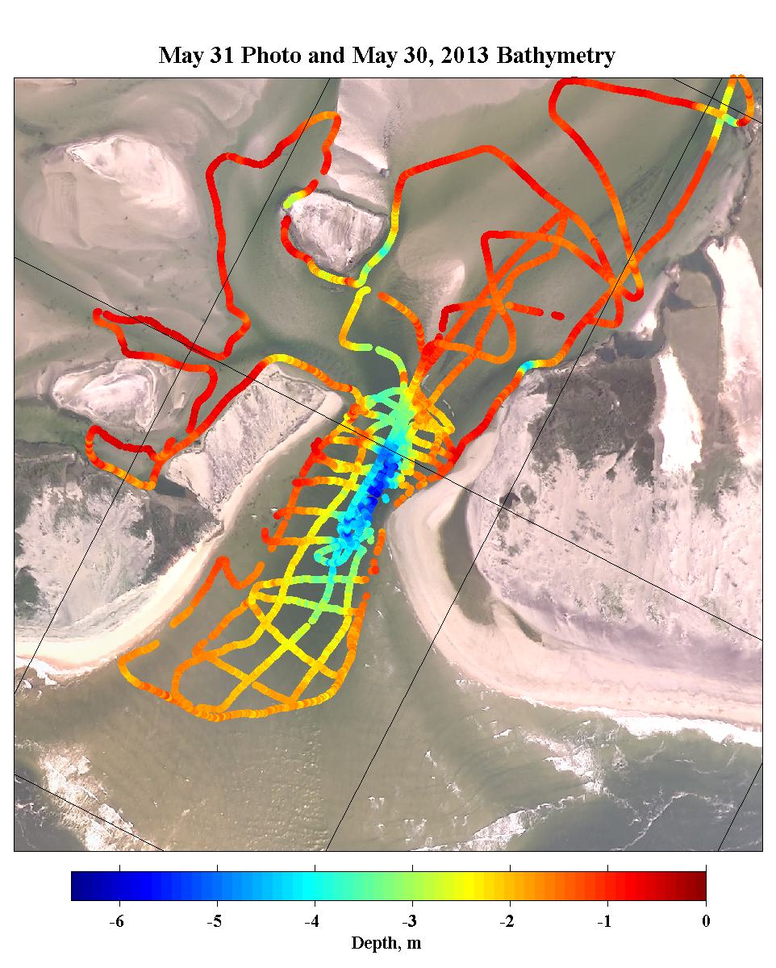
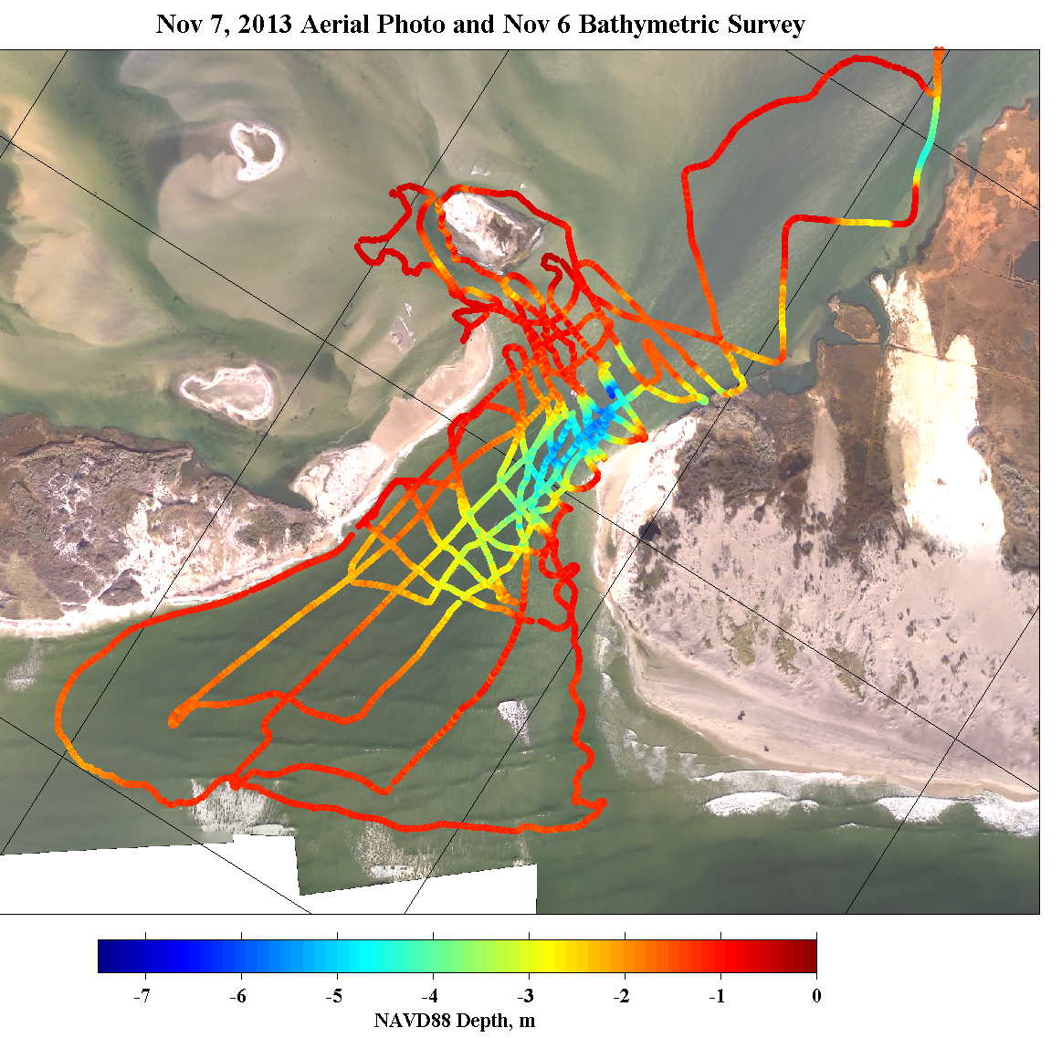
Bathymetric Surveying

Slide 13
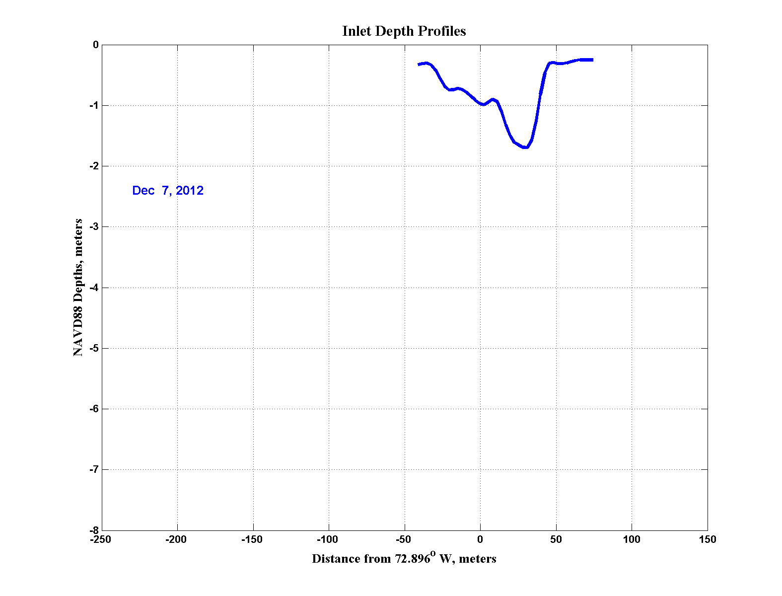
Inlet Bottom Profiles Across the Deepest Section

Slide 14
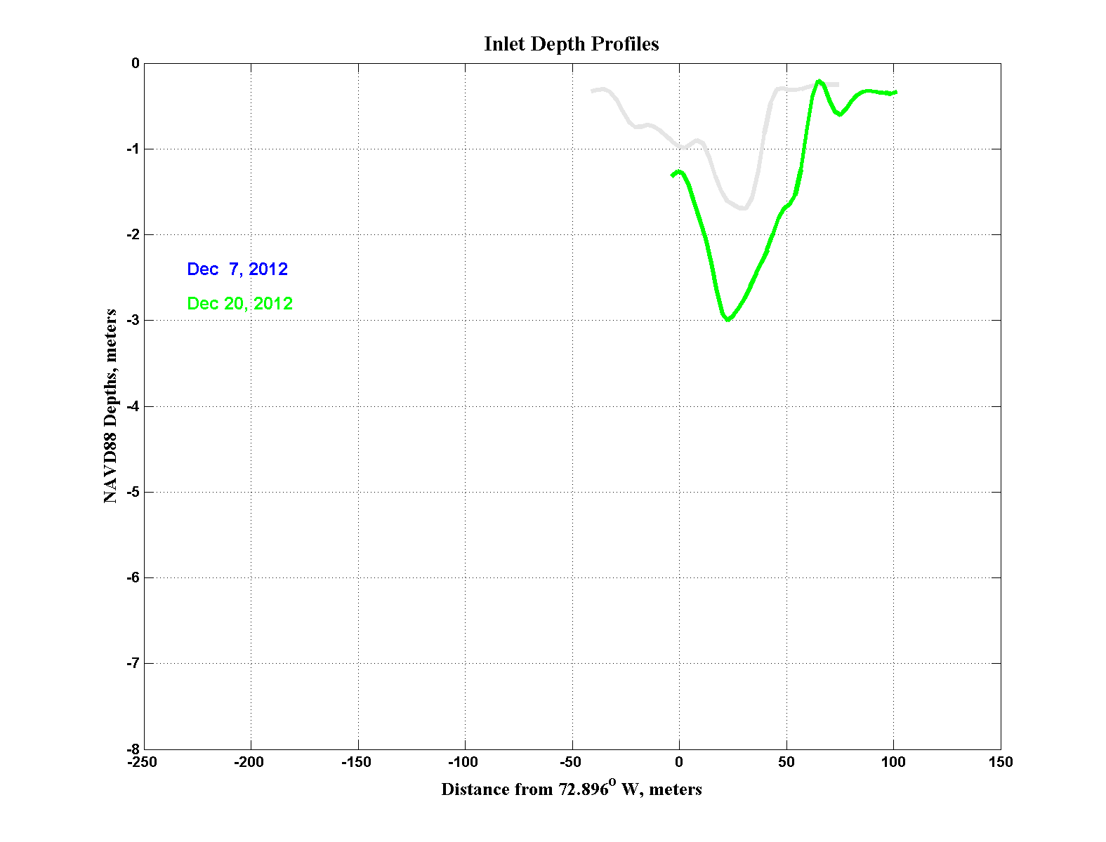
Inlet Bottom Profiles Across the Deepest Section

Slide 15
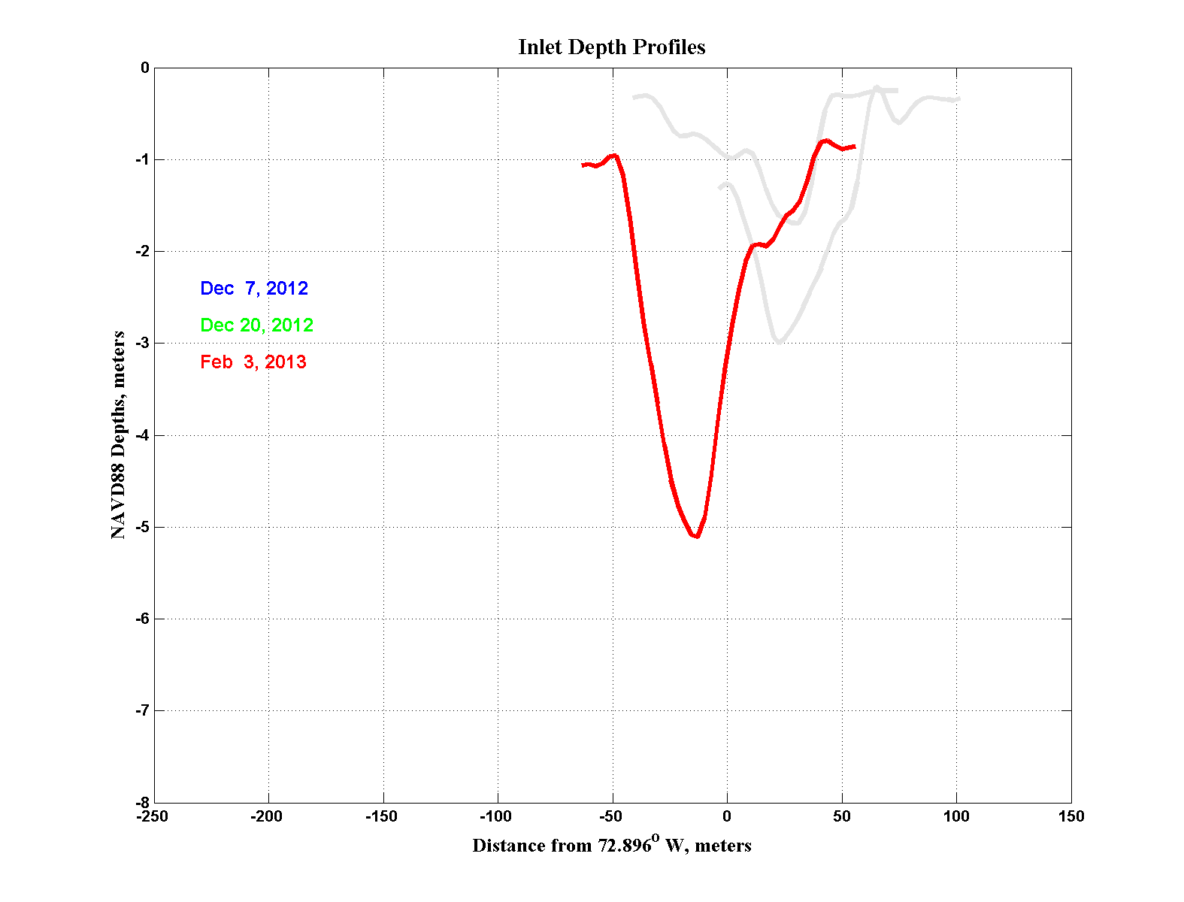
Inlet Bottom Profiles Across the Deepest Section

Slide 16
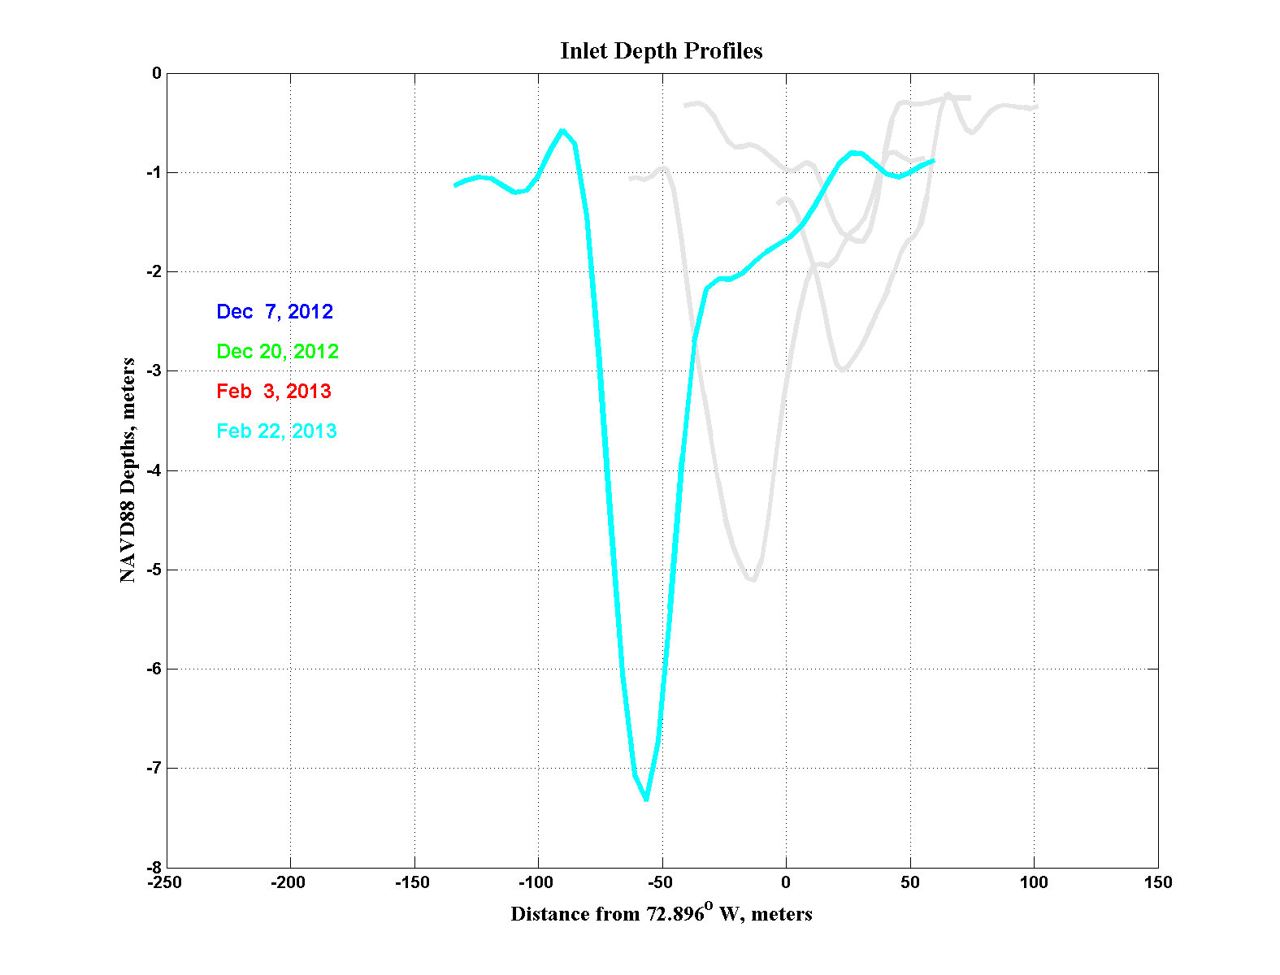
Inlet Bottom Profiles Across the Deepest Section

Slide 17
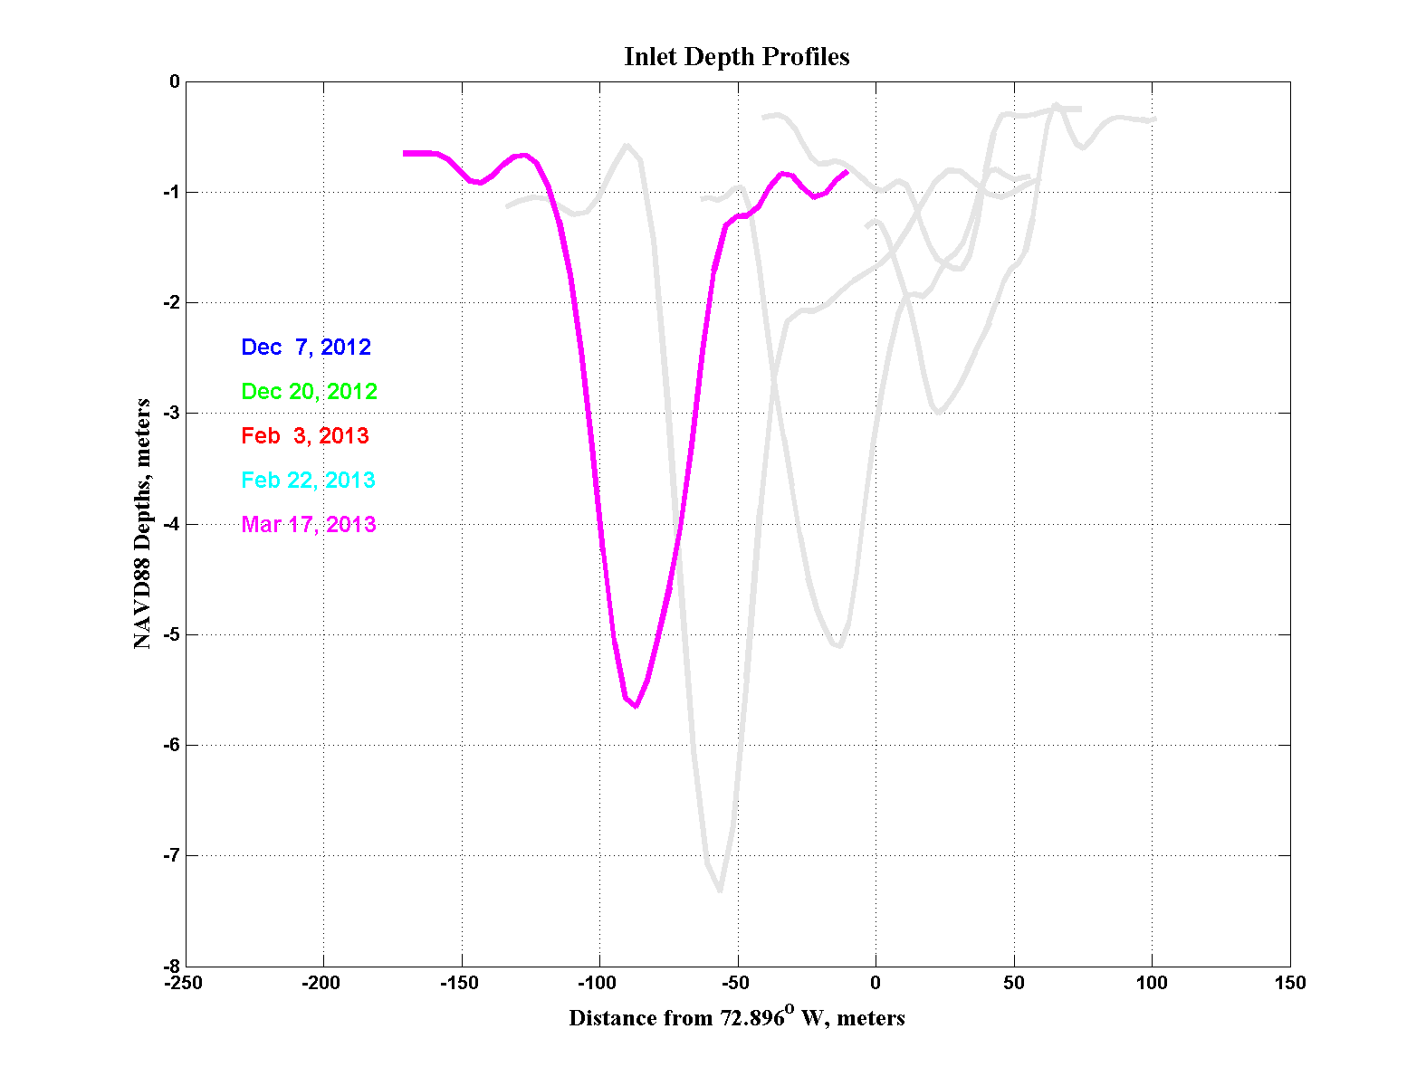
Inlet Bottom Profiles Across the Deepest Section

Slide 18
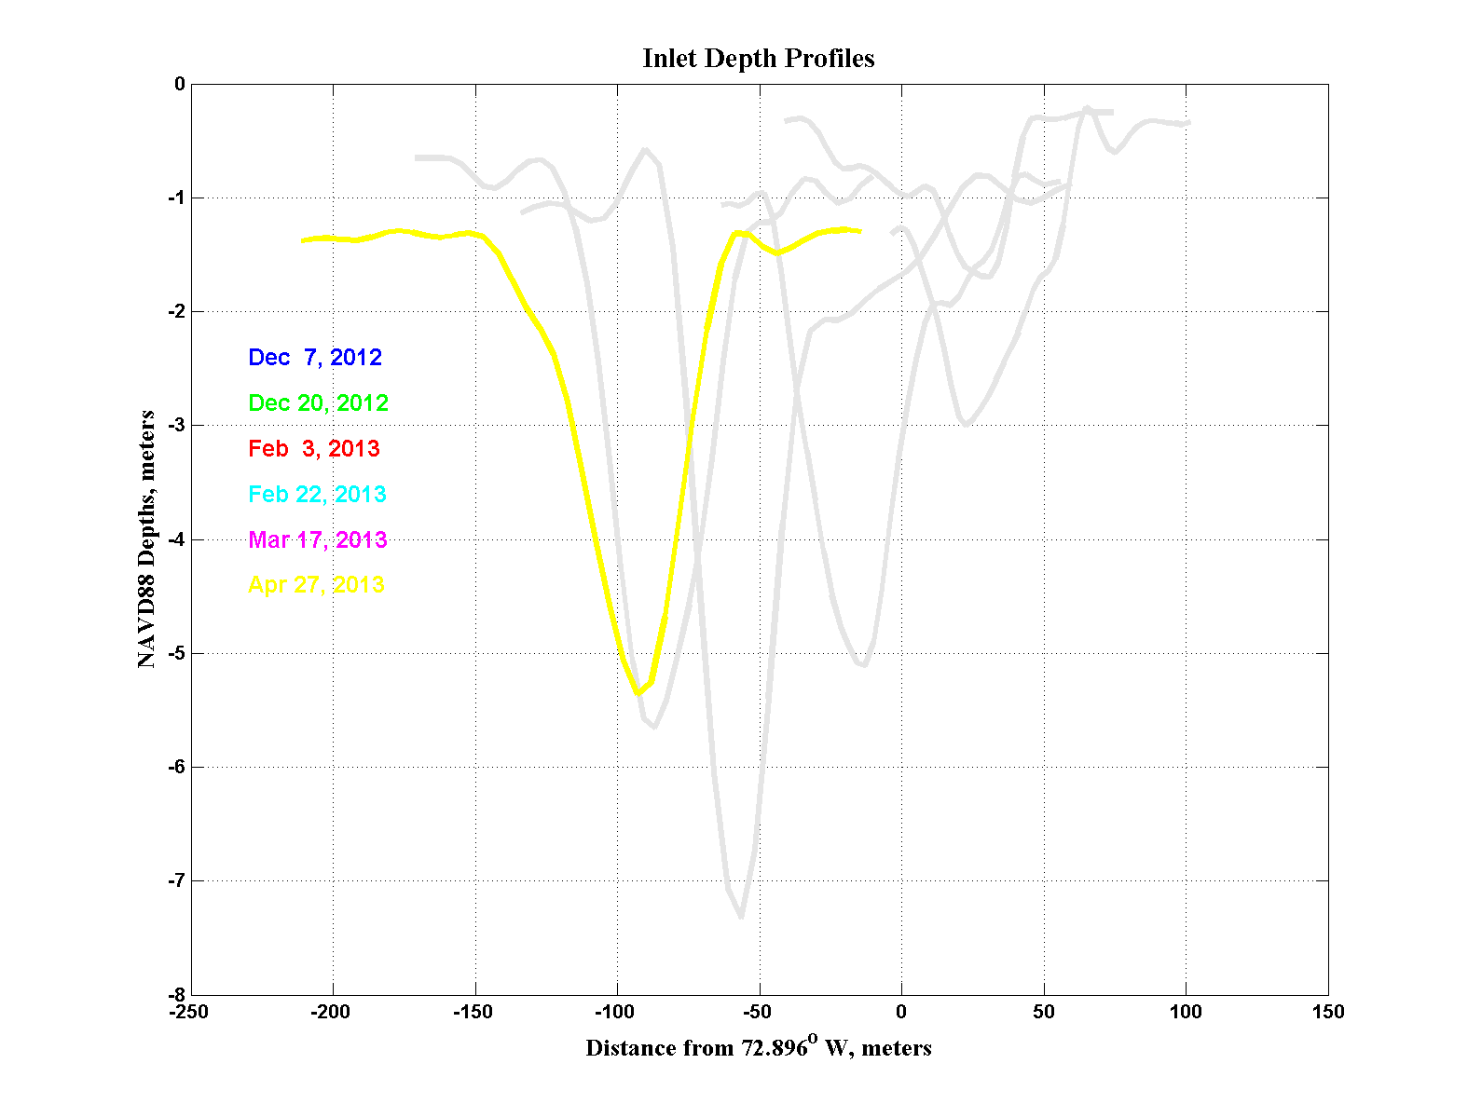
Inlet Bottom Profiles Across the Deepest Section

Slide 19
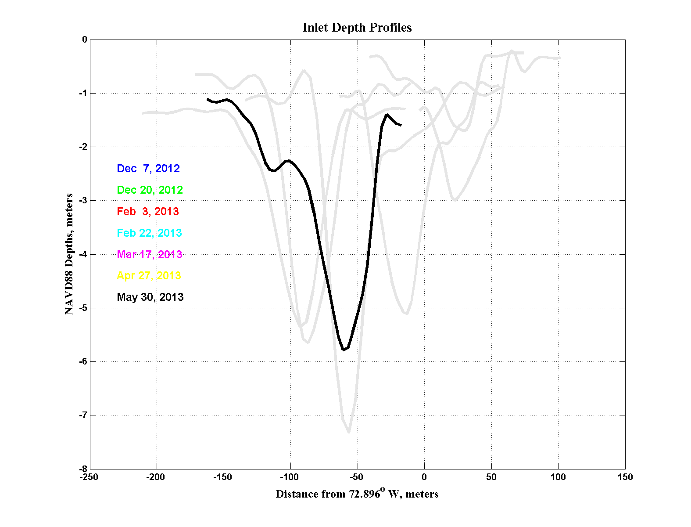
Inlet Bottom Profiles Across the Deepest Section

Slide 20
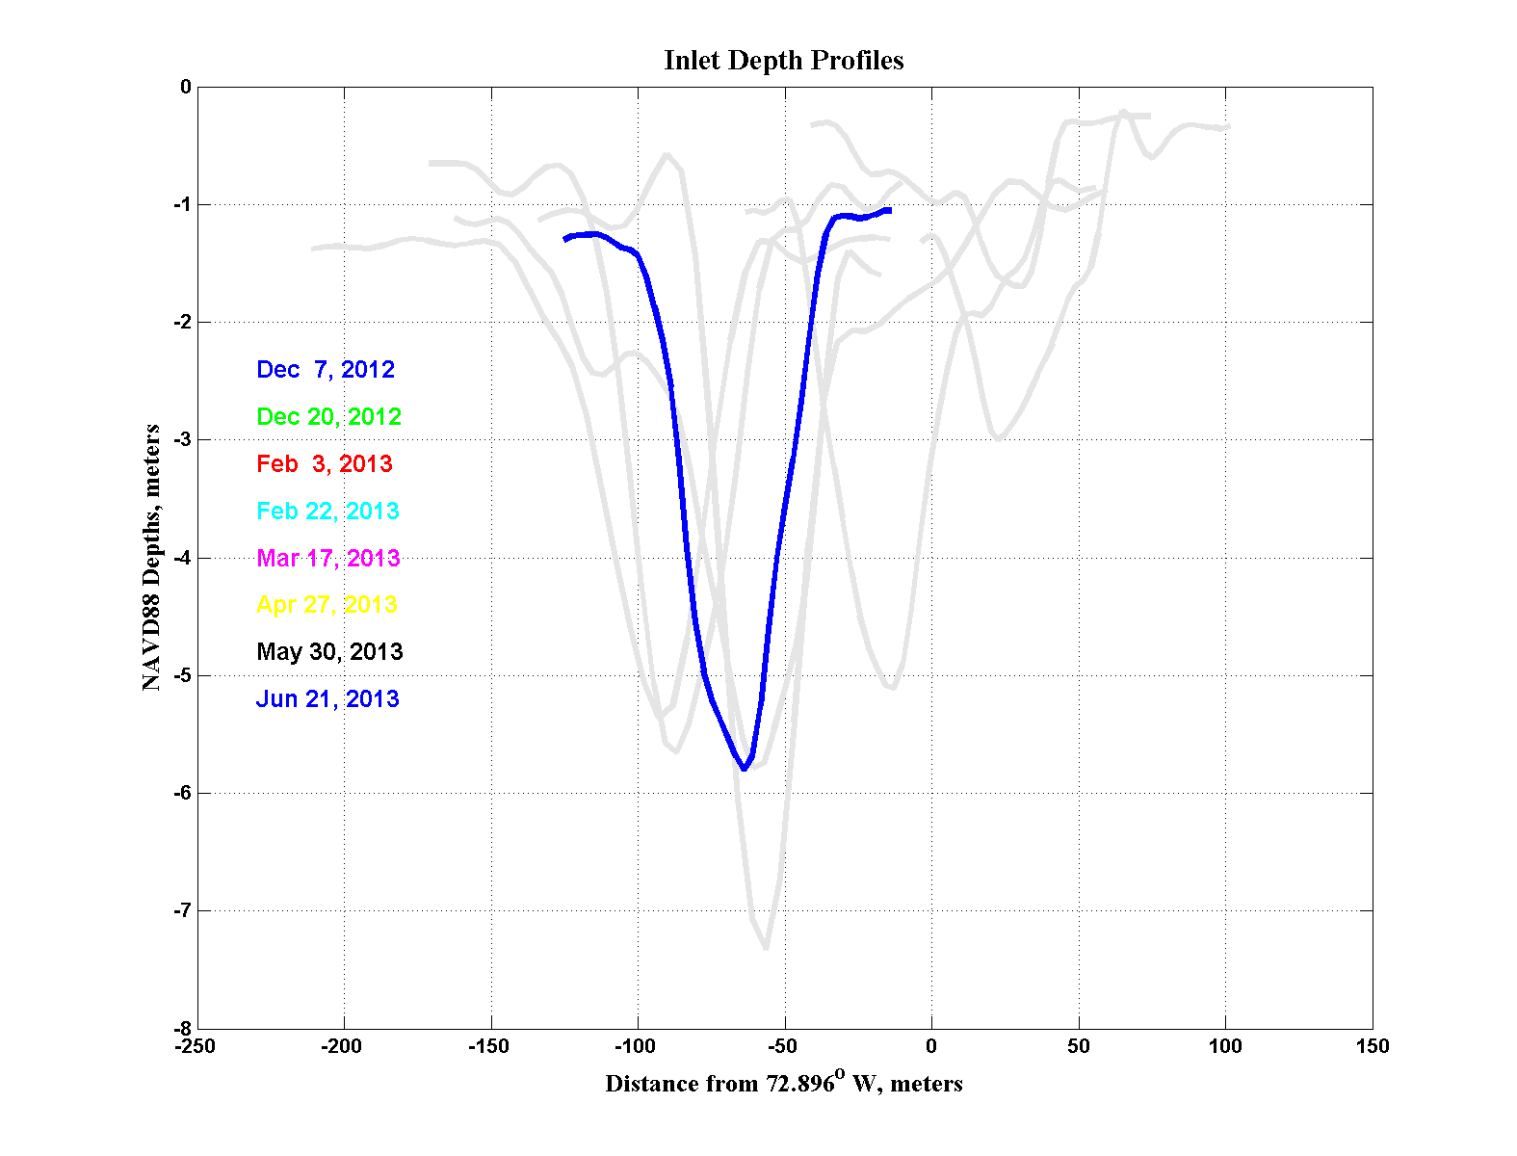
Inlet Bottom Profiles Across the Deepest Section

Slide 21
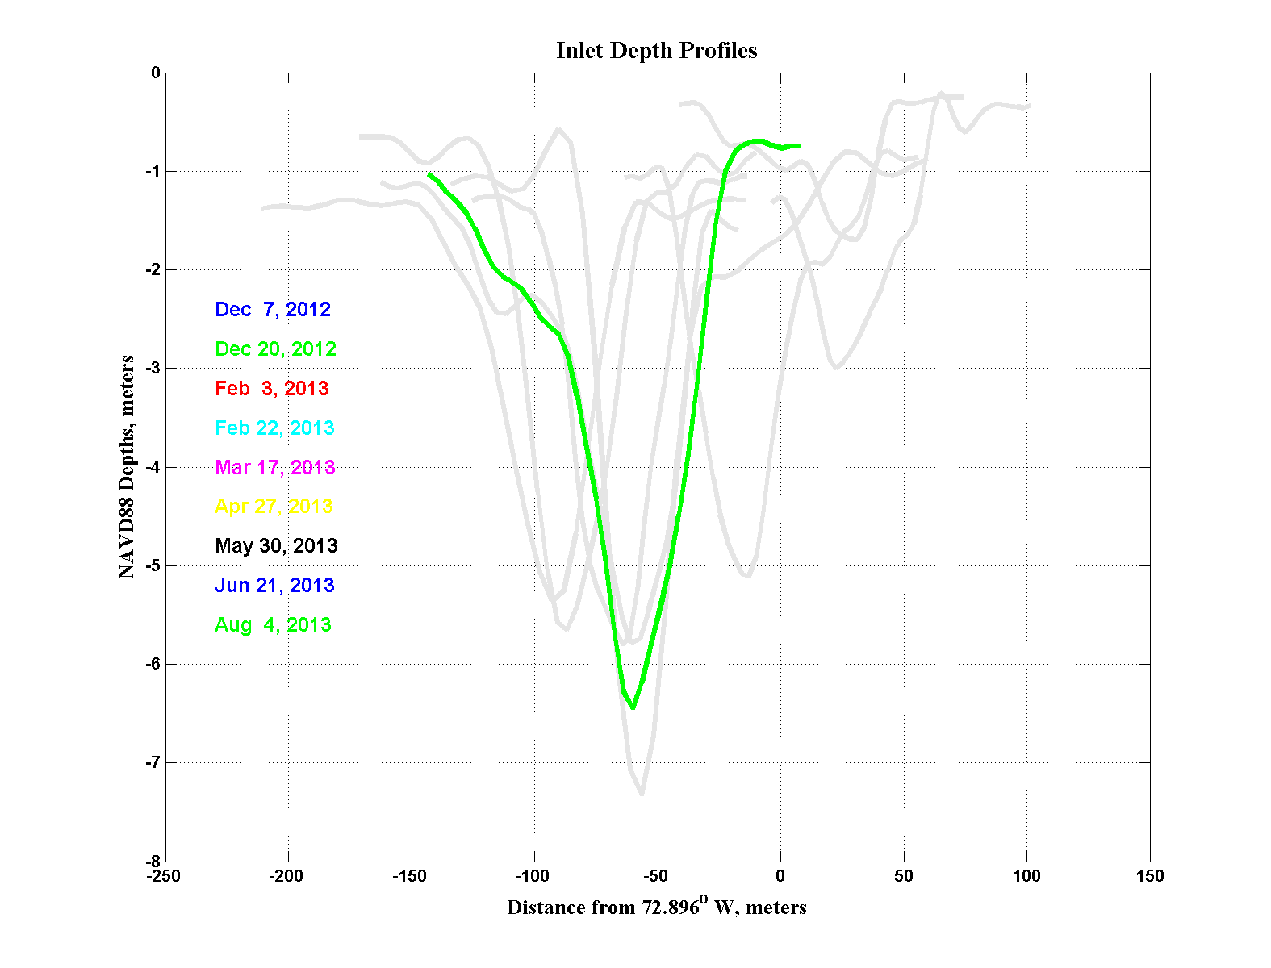
Inlet Bottom Profiles Across the Deepest Section

Slide 22
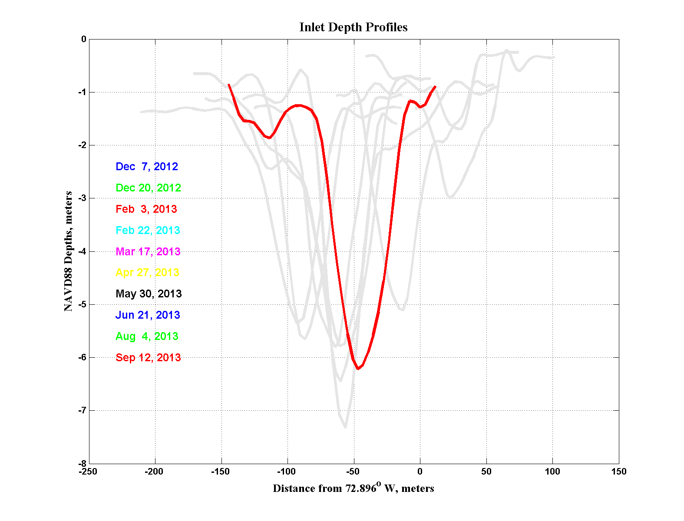
Inlet Bottom Profiles Across the Deepest Section

Slide 23
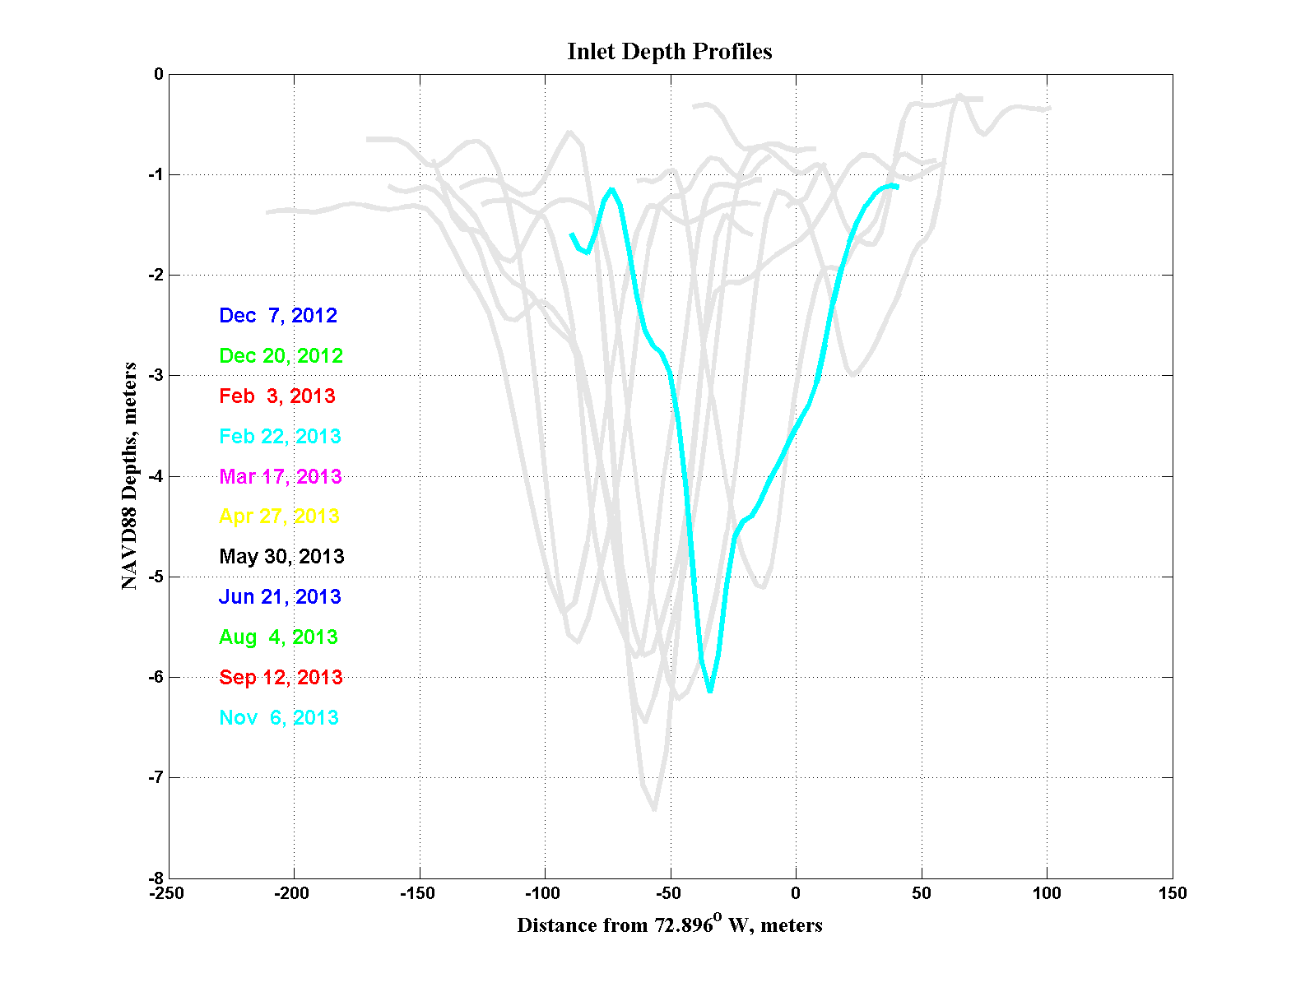
Inlet Bottom Profiles Across the Deepest Section

Slide 24
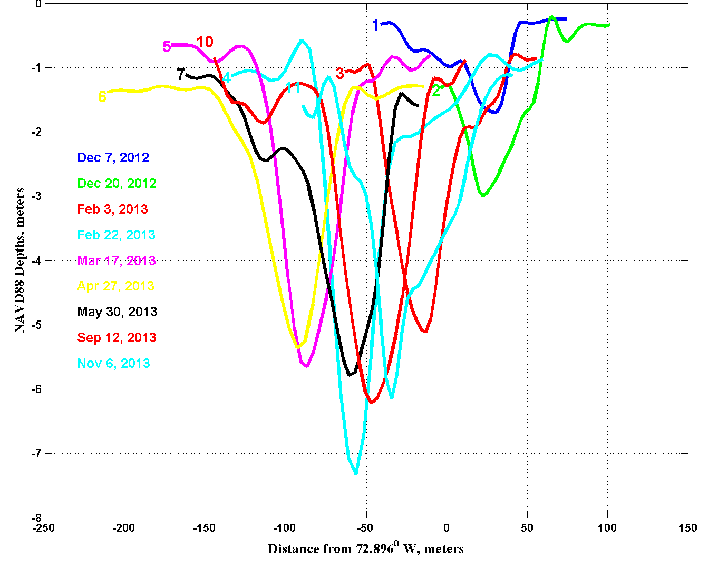
Inlet Bottom Profiles Across the Deepest Section
Latest Profile
Nov 6, 2013

Slide 25
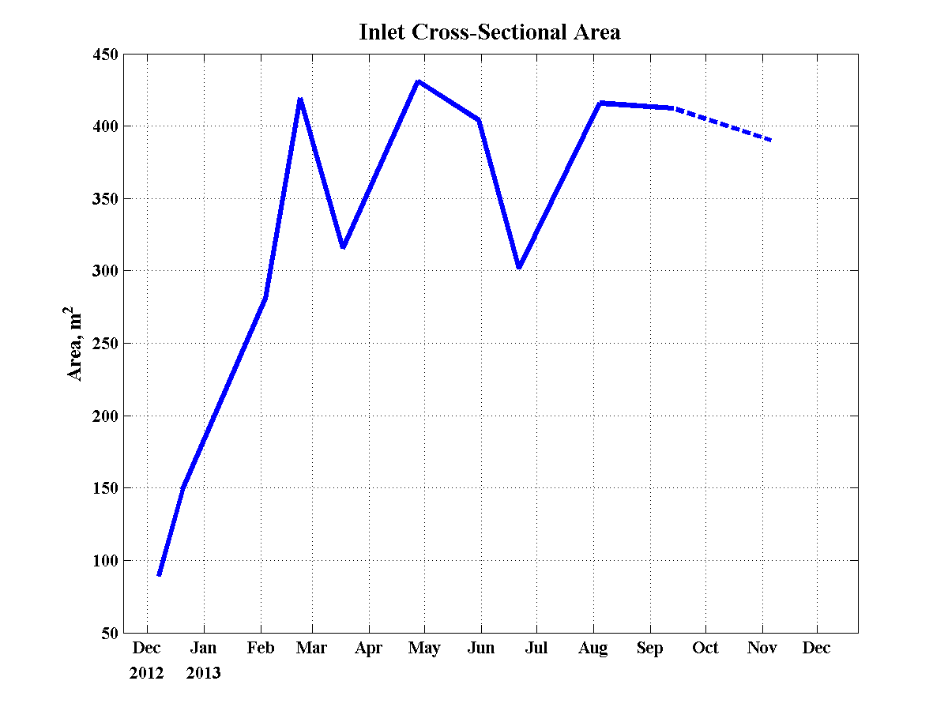
New Inlet
~400 m²
Fire Island Inlet ~ 4000 m²
Moriches Inlet ~ 800 m²
Total ~ 4800 m²
Area
New Inlet is ~ 8% of Total

Slide 26
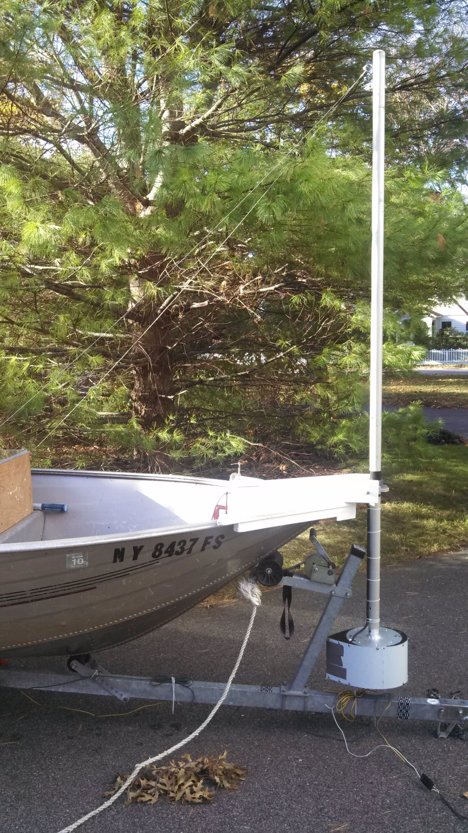
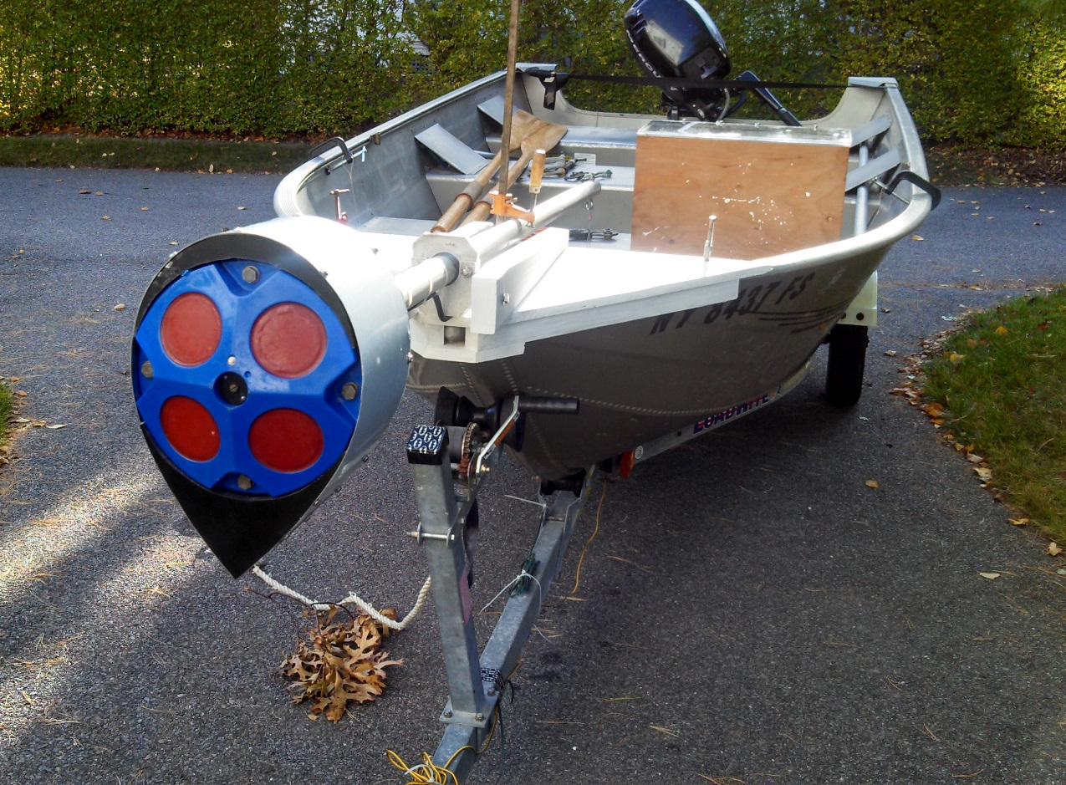
Velocity Survey of the Inlet, November 17, 2013
Acoustic Doppler Current Profiler (ADCP) mounted on a 14’ skiff.
1200 kHz RDI Workhorse ADCP

Slide 27
Velocity Survey of the Inlet, November 17, 2013
Boat Track
70 round trips across main transect
from slack after high water to slack after low water.

Slide 28
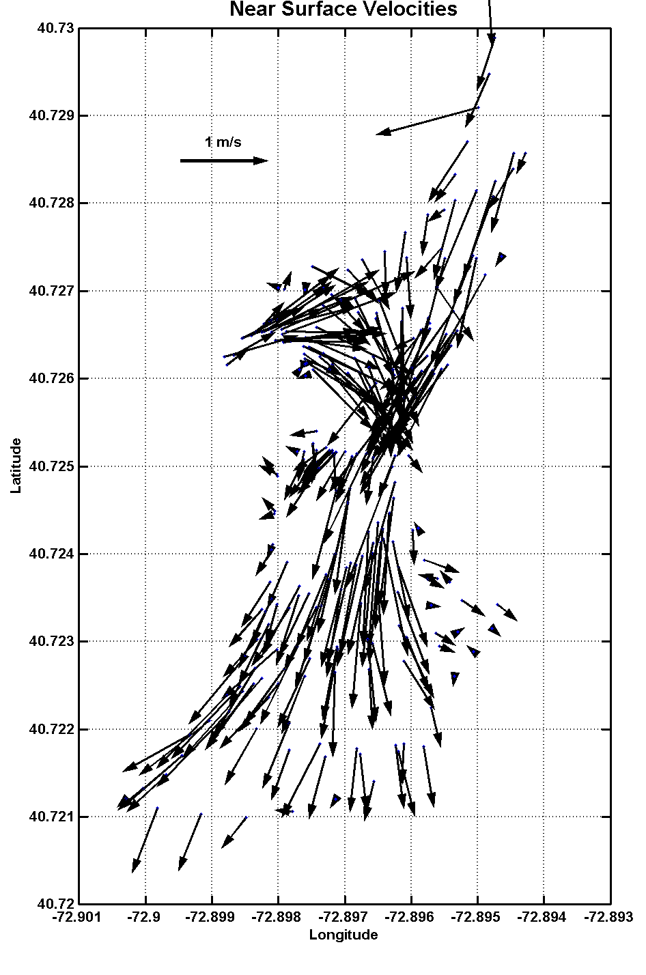
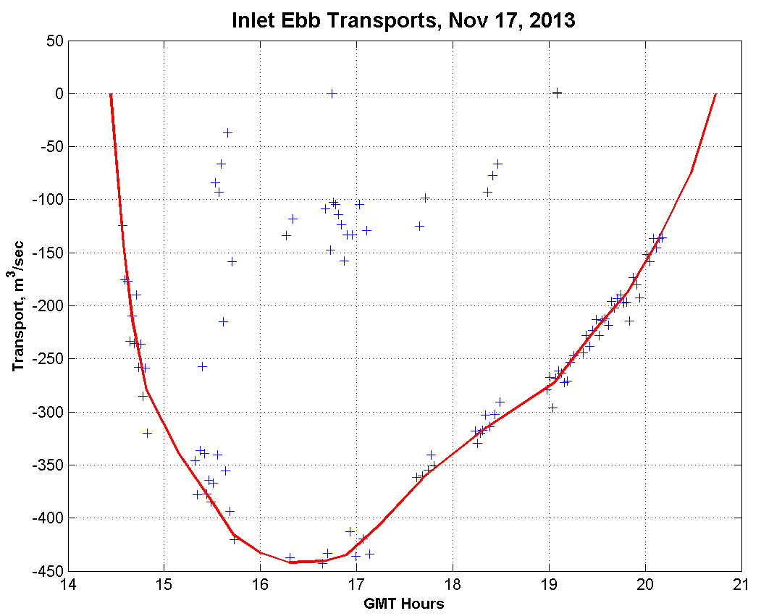
Velocity Survey of the Inlet, November 17, 2013
1 m/s
Maximum observed current: 2.2 m/s (4.7 kts)
Maximum ebb transport: 445 m³/s
Total ebb transport: 6.8 x 10⁶ m³

Slide 29
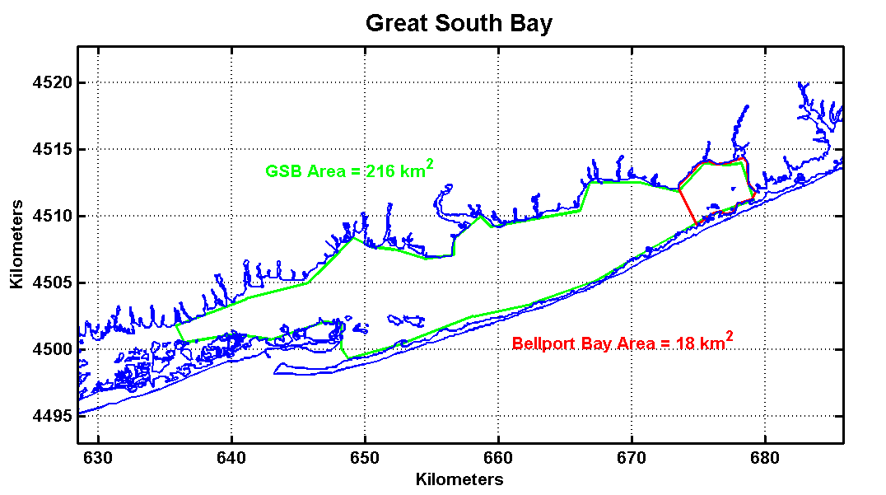
GSB Area = 216 km²
New
Inlet
Bellport Bay Area = 18 km²
Tidal range at Bellport on November 17 was 0.39 m, so the area directly affected by the transport through the inlet was
6.8 x 10⁶ m³ /0.39 m = 17.6 km².
This area is approximately the size of Bellport Bay and 8% of the larger Great South Bay.

Slide 31
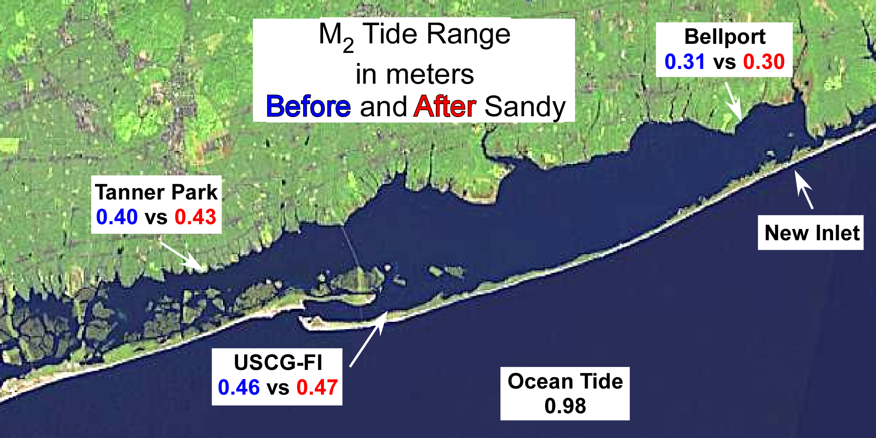

Slide 32
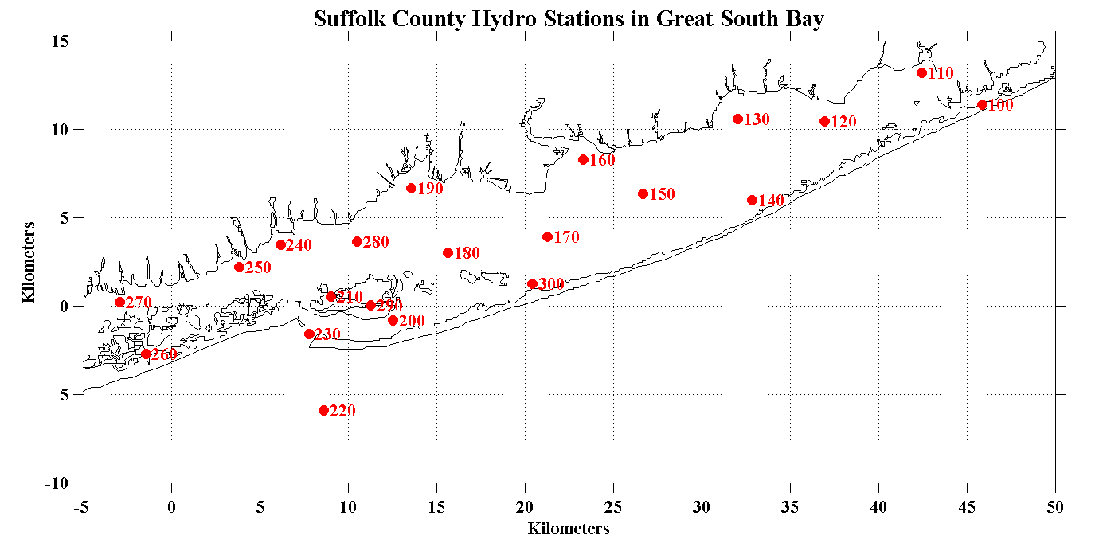
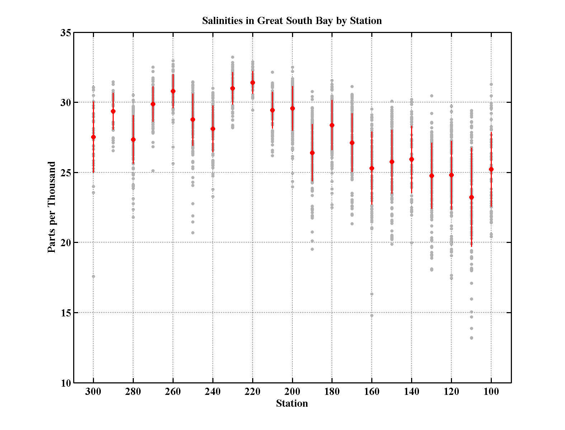
Salinities in Great South Bay by Station
Bellport Bay
Ocean

Slide 33
Records from Bellport and the GSB1 Buoy show the effects of the increased ocean-bay exchange in Bellport Bay.

Slide 34
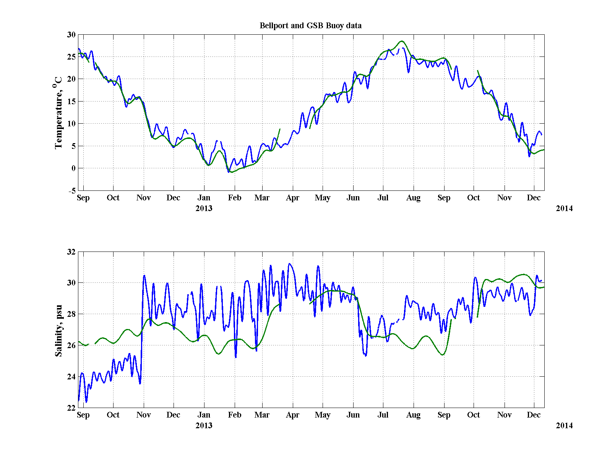
Bellport
GSB Buoy
FI Inlet
Dredging
9” Rain
More
Dredging ?
Sandy
Brown Tide
Ocean ~31
Bellport
GSB Buoy

Slide 35
Circulation within Great South Bay, Tides and Wind

Slide 36
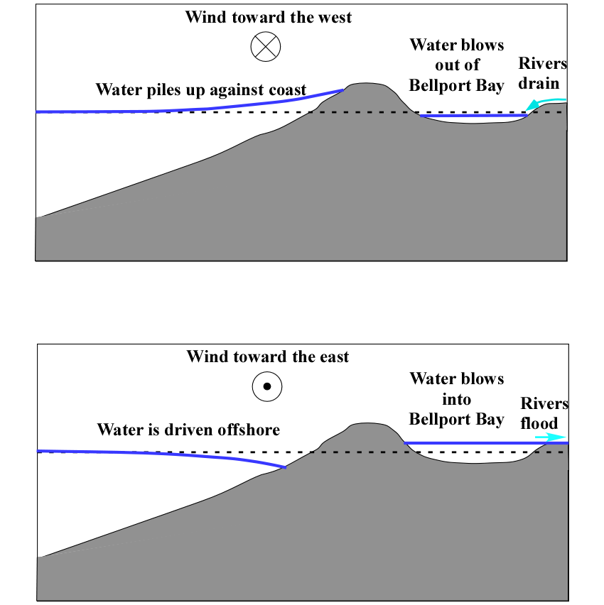
Wind Direction vs Bellport Water Level
Typical Nor’easter
or
Approaching Hurricane
Cold Outbreak
with Winds from
the northwest

Slide 37
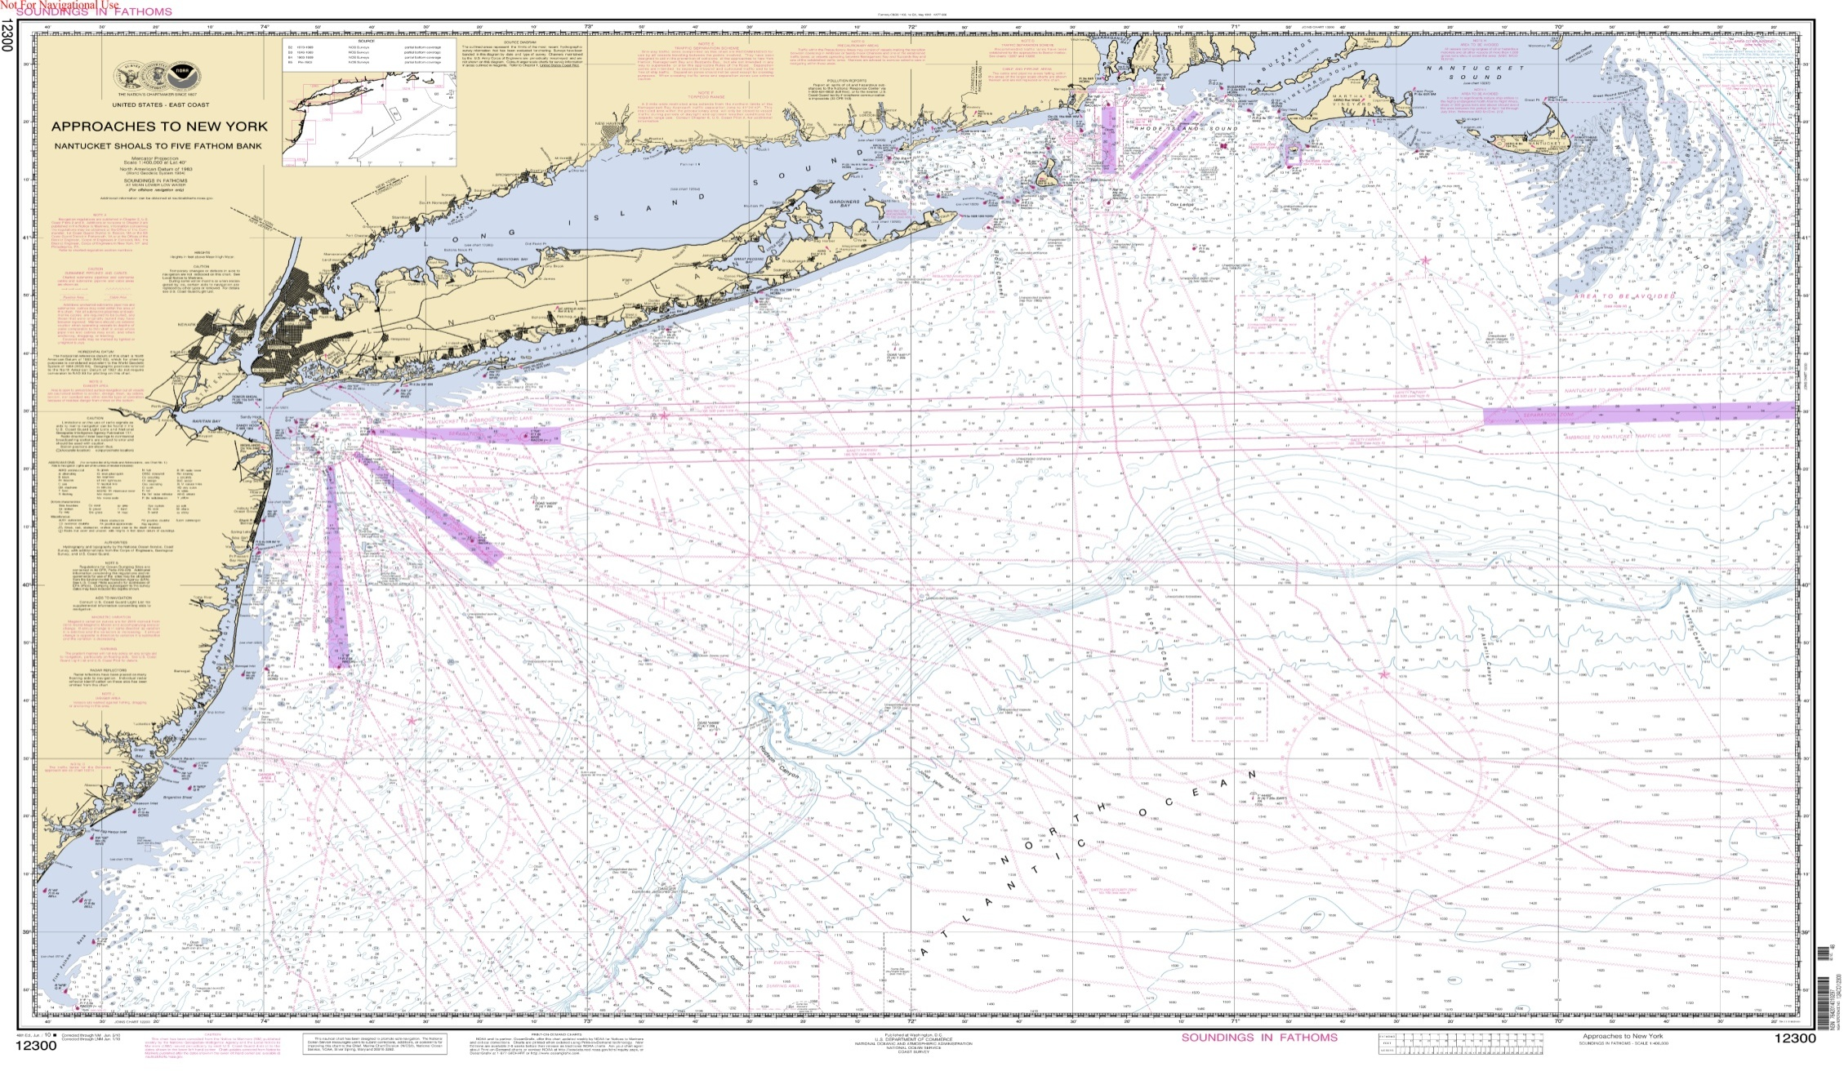
We have seen Wide Spread Sea Level Fluctuations
Woods Hole
Bellport
Lindehurst
Atlantic City
Chesapeake Bay

Slide 38
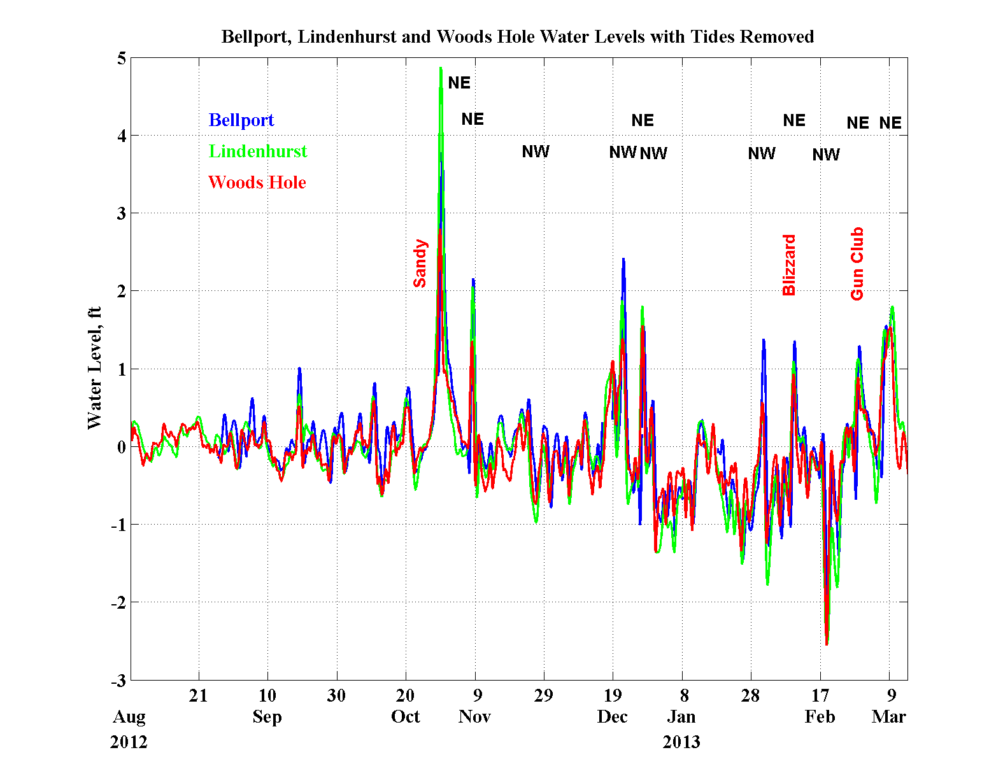

Slide 39
Summary
The outer inlet has increased in size and moved west while the cross-sectional area has remained relatively stable for ~9 months.

Slide 40
Summary
The outer inlet has increased in size and moved west while the cross-sectional area has remained relatively stable for ~9 months.
With the extended spit along the western edge, the inlet is continuing its rotation and growing longer, as happens with natural inlets.

Slide 41
Summary
The outer inlet has increased in size and moved west while the cross-sectional area has remained relatively stable for ~9 months.
With the extended spit along the western edge, the inlet is continuing its rotation and growing longer, as happens with natural inlets.
The inlet is relatively small compared to the other inlets, < 8% of the cross-sectional areas with < 8% of the tidal exchange.

Slide 42
Summary
The outer inlet has increased in size and moved west while the cross-sectional area has remained relatively stable for ~9 months.
With the extended spit along the western edge, the inlet is continuing its rotation and growing longer, as happens with natural inlets.
The inlet is relatively small compared to the other inlets, < 8% of the cross-sectional areas with < 8% of the tidal exchange.
There has been an increased exchange of waters with the ocean in the eastern Great South Bay, and this has clearly improved the water quality and reduced the impact of Brown Tides.

Slide 43
Summary
The outer inlet has increased in size and moved west while the cross-sectional area has remained relatively stable for ~9 months.
With the extended spit along the western edge, the inlet is continuing its rotation and growing longer, as happens with natural inlets.
The inlet is relatively small compared to the other inlets, < 8% of the cross-sectional areas with < 8% of the tidal exchange.
There has been an increased exchange of waters with the ocean in the eastern Great South Bay, and this has clearly improved the water quality and reduced the impact of Brown Tides.
We experienced unusually frequent storms during last winter, which caused repeated local flooding events but these are not historically exceptional.

Slide 44
Summary
The outer inlet has increased in size and moved west while the cross-sectional area has remained relatively stable for ~9 months.
With the extended spit along the western edge, the inlet is continuing its rotation and growing longer, as happens with natural inlets.
The inlet is relatively small compared to the other inlets, < 8% of the cross-sectional areas with < 8% of the tidal exchange.
There has been an increased exchange of waters with the ocean in the eastern Great South Bay, and this has clearly improved the water quality and reduced the impact of Brown Tides.
We experienced unusually frequent storms during last winter, which caused repeated local flooding events but these are not historically exceptional.
Bay waters will respond to storm-forced ocean surges, with or without the inlet.

